Slide 1

THE SENIOR ADVOCATE OF NIGERIA: ORIGIN, EVOLUTION, AND ROLE OF THE RANK IN SHAPING NIGERIA'S LEGAL PROFESSION
PROF. YUSUF ALI SAN, FCIArb.

Slide 2
Presentation Outline
Abstract
Introduction
The Rank of SAN – meaning and what it represents
Historical Foundation and Evolution of the Rank of SAN
Privileges and Restrictions of the Rank of SAN
The Role and Significance of the Rank of SAN in shaping the Legal Profession
Challenges and Criticisms of the SAN Rank
The Future of the Rank of SAN
Core Attributes of a SAN
A Charge to the new SANs
Conclusion

Slide 3

ABSTRACT
The Rank of Senior Advocate of Nigeria (SAN), remains the highest professional distinction in Nigeria’s legal system.
Holders of the rank have played pivotal roles in landmark cases and contributed significantly to the legal profession.
This paper traces the origin and evolution of the SAN rank, critically examines its transformative role in shaping Nigeria’s legal profession, and argues that sustaining its legacy requires a renewed commitment to excellence and service to justice.

Slide 4

Introduction
The ranking of courtroom advocates for exceptional contributions to the administration of justice is a historical tradition practiced in the United Kingdom (UK). The title is referred to as King’s Counsel or Queen’s Counsel, depending on the monarch in power.
In Nigeria, this distinction is encapsulated in the conferment of the rank of Senior Advocate of Nigeria (SAN)
The conferment of the rank of SAN represents the highest mark of distinction and honour attainable by a legal practitioner in Nigeria.
In this presentation, we will examine the origin of the SAN rank, its evolution over the years, and the profound role it continues to play in shaping the Nigerian legal profession.

Slide 5
This presentation will address the following questions:
1
2
What is the meaning of the rank of SAN and what does it represent?
What are the privileges and restrictions of the rank of SAN?
What is the historical foundation and evolution of the rank of SAN?
What is the significance of the rank of SAN in shaping the legal profession?
3
4

Slide 6

The Rank of SAN: meaning and what it represents
SAN stands for Senior Advocate of Nigeria.
It is an honorary rank that is conferred on distinguished legal practitioners in Nigeria with not less than ten years post-call practice experience and who have achieved recognition for their advocacy and contributions to the profession.
It may also be conferred on a legal practitioner who is not engaged in full and active practice but has excelled in the academic sphere.
The SAN rank represents the pinnacle of achievement at the Bar, symbolizing not only exceptional skill in legal practice but also the highest standards of professional ethics.

Slide 7

History and Evolution of the Rank of SAN
The introduction of the rank of SAN began with the introduction of English laws in Nigeria and the efforts of Nigerian lawyers to attain the prestigious rank of Queen’s Counsel.
The Queen’s Counsel (QC), or King’s Counsel (KC) when the reigning monarch is male, originated from England.
The first Queen’s Counsel was Sir Francis Bacon, who received a patent granting him precedence at the bar in 1603.
The rank of the Queen’s Counsel is linked to our colonial roots. The history of Nigeria’s present legal system can be traced directly to the introduction of English law into the then Lagos colony.

Slide 8
In 1863, the Lagos Supreme Court was established, and by the 1876 Ordinance, legal practitioners could be admitted formally, though due to the scarcity of qualified lawyers, courts also permitted “local-made solicitors,” “colonial solicitors,” or “self-taught attorneys.”
However, the proclamation of the protectorates brought a surge of African lawyers, and as the number of qualified practicing lawyers increased, the reliance of local attorneys reduced.
While Nigeria’s bar admission requirements mirrored the UK’s, unlike England, where distinguished barristers could attain the rank of QC, no equivalent professional honor existed in Nigeria.
In 1903, Governor Sir William MacGregor’s attempt to secure the rank of King’s Counsel for Nigerian lawyer C.A. Sapara Williams failed, as colonial bias led to the rejection despite his outstanding credentials.

Slide 9
In 1939, M. Rhodes pushed for African lawyers to be appointed as King’s Counsels, but the proposal was rejected on the claim that it would restrict their practice to costly cases. Consequently, despite many accomplished African lawyers since the 1880s, none had received the KC or Q rank.
In 1958, the Federal Attorney-General proposed creating the rank of Queen’s Counsel for Nigerian lawyers, leading to the Queen’s Counsel Ordinance No. 54 of 1958.
In 1959, Chiefs H.O. Davies and F.R.A. Williams became the first Nigerians so appointed, but the rank was abolished in 1964 after Nigeria became a Republic.

Slide 10
After the abolition of the QC title, the Legal Practitioners (Amendment) Decree No. 25 of 1974 introduced the rank of Senior Advocate of Nigeria (SAN).
The first recipients were Chief F.R.A. Williams and Dr. Nabo Graham-Douglas in 1975.
Since then, the SAN rank has evolved into a highly prestigious title, now governed by Section 5(1–2) of the Legal Practitioners Act and conferred by the Legal Practitioners’ Privileges Committee (LPPC
The SAN rank, born from the colonial QC rank, has grown into a lasting tradition upholding honor and excellence in Nigerian legal practice.

Slide 11
Privileges and Restrictions of the Rank of SAN
PRIVILEGES
Exclusive Right to the Inner Bar
Right of Precedence
Wearing of Silk
Professional Recognition
RESTRICTIONS
Limitation on Appearances in Court
Ethical Expectations
Limitation on Application for Processes
Obligation to Excellence
Minimum Fees
Regulation by the LPPC

Slide 12

The Role and of SAN in shaping the Legal Profession
A Senior Advocate of Nigeria has seven principal roles in shaping the legal profession:
Assist the Court in achieving Justice
Advocacy, Jurisprudence and Legal Scholarship
Ethical Leadership and Mentorship
Guard the sanctity of the Legal Profession
Guardians of the Profession’s Prestige
Contributions to Legal and Constitutional Development
Influence on Legal Education

Slide 13

CHALLENGES AND CRITICISMS OF THE SAN RANK
Transparency and Credibility of the Conferment Process
Cost and Burden of Application
Decline in Ethical Standards among Some SANs
Over-Concentration of Opportunities
Limited Representation of Diversity
Restriction to Superior Courts
NOTE: Significant reforms have been introduced over the years to make the process of attaining the rank of Senior Advocate of Nigeria (SAN) more transparent and credible.

Slide 14

The Future of the Rank of SAN
Four key areas stand out in envisioning the future of the rank.
Sustaining Excellence and Integrity
Strengthening Mentorship Obligations
Promoting Diversity
Adapting to Changes in Legal Practice

Slide 15

Core Attributes of a SAN
Integrity
Honesty
Loyalty to the Profession
Respect
Humility
Candor
Knowledge
Fiduciary Openness
Competence
Personal Conduct (Private and Public)
Respect for Seniority
Probity

Slide 16
A charge to the new senior advocates of Nigeria
“Wear the silk with pride, but also with restraint. Let it remind you daily of the greater duty you owe to justice, to the profession, and to the Nigerian people. For it is only by living these values that the rank of Senior Advocate of Nigeria will continue to shine as a mark of excellence, and only by your example that the next generation will learn what it truly means to be a leader of the Bar.”

Slide 17
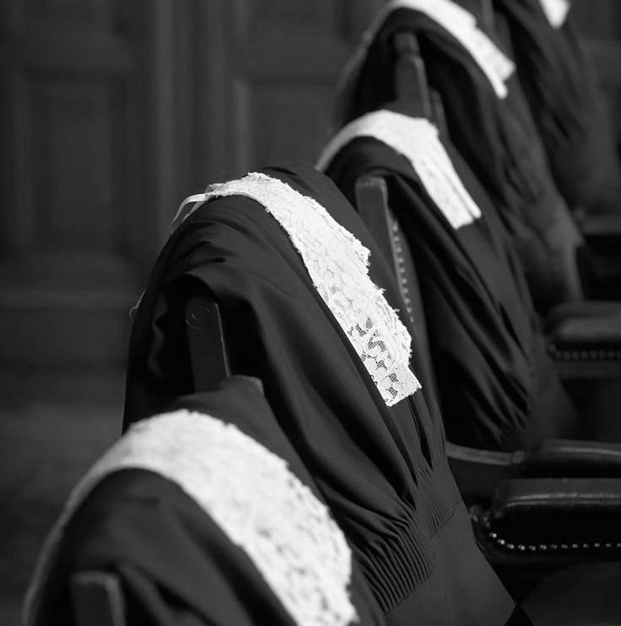
CONCLUSION
The rank of SAN is far more than an honorific title; it is an enduring institution at the heart of Nigeria’s legal identity. As a legacy institution, it carries with it obligations that transcend personal achievement.
Dear Learned Silks, to be conferred with the silk is to accept a lifelong duty of service to mentor the next generation of lawyers, to advocate for the rule of law and human rights, and to support reforms that keep the profession responsive to Nigeria’s changing social and political realities.

Slide 18


Thanks for listening!
PROF. YUSUF ALI SAN, FCIArb.

